Slide 1
Fundamentals of Data Science
Ch 5: Data visualization to the end user
First Semester 2022/2023

Slide 2
Data scientists must deliver their new insights to the end user.
The results can be communicated in several ways
A one-time presentation—Research questions are one-shot deals because the business decision derived from them will bind the organization to a certain course for many years to come.
A new viewport on your data—The most obvious example here is customer segmentation. Sure, the segments themselves will be communicated via reports and presentations, but in essence they form tools, not the end result itself. When a clear and relevant customer segmentation is discovered, it can be fed back to the database as a new dimension on the data from which it was derived.
A real-time dashboard—Sometimes your task as a data scientist doesn’t end when you’ve discovered the new information you were looking for. You can send your information back to the database and be done with it. But when other people start making reports on this newly discovered gold nugget, they might interpret it incorrectly and make reports that don’t make sense.

Slide 3
Data visualization factors
What kind of decision are you supporting? Is it a strategic or an operational one? Strategic decisions often only require you to analyze and report once, whereas operational decisions require the report to be refreshed regularly.
How big is your organization? In smaller ones you’ll be in charge of the entire cycle: from data gathering to reporting. In bigger ones a team of reporters might be available to make the dashboards for you. But even in this last situation, delivering a prototype dashboard can be beneficial because it presents an example and often shortens delivery time

Slide 4
Business Reporting Definitions and Concepts
Report = Information → Decision
Report?
Any communication artifact prepared to convey specific information
A report can fulfill many functions
To ensure proper departmental functioning
To provide information
To provide the results of an analysis
To persuade others to act
To create an organizational memory…

Slide 5
What is a Business Report?
A written document that contains information regarding business matters.
Purpose: to improve managerial decisions
Source: data from inside and outside the organization (via the use of ETL)
Format: text + tables + graphs/charts
Distribution: in-print, email, portal/intranet
Data acquisition → Information generation → Decision making → Process management

Slide 6
Business Reporting

Slide 7
Key to Any Successful Report
Clarity …
Brevity …
Completeness …
Correctness …
Report types (in terms of content and format)
Informal – a single letter or a memo
Formal – 10-100 pages; cover + summary + text
Short report – periodic, informative, investigative

Slide 8
Data and Information Visualization
“The use of visual representations to explore, make sense of, and communicate data.”
Data visualization vs. Information visualization
Information = aggregation, summarization, and contextualization of data
Related to information graphics, scientific visualization, and statistical graphics
Often includes charts, graphs, illustrations, …

Slide 9
Different Types of Charts and Graphs
Which one to use? Where and when?
Basic Charts and Graphs
Line Chart
Bar Chart
Pie Chart
Scatter Plot
Bubble Chart
Specialized Charts and Graphs
Histogram
Gantt Chart
PERT Chart
Geographic Map
Bullet Graph
Heat Map / Tree Map
Highlight Table

Slide 10
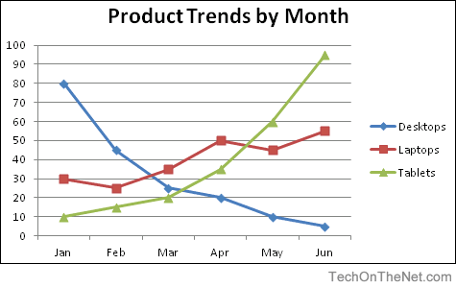
Line Chart

Slide 11
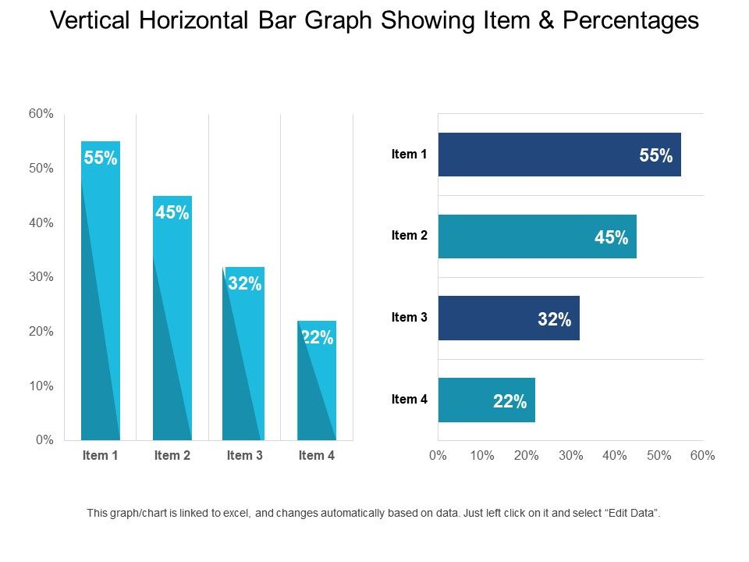
Bar Chart

Slide 12
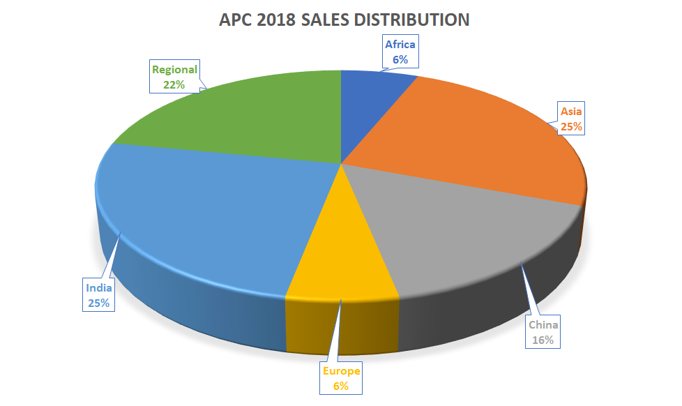
Pie Chart

Slide 13
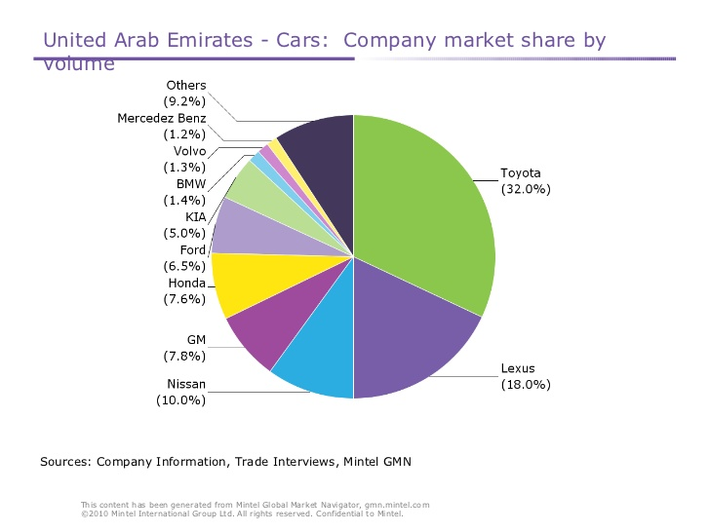

Slide 14
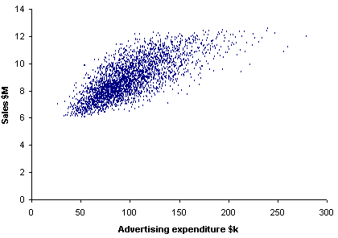
Scatter Plot

Slide 15
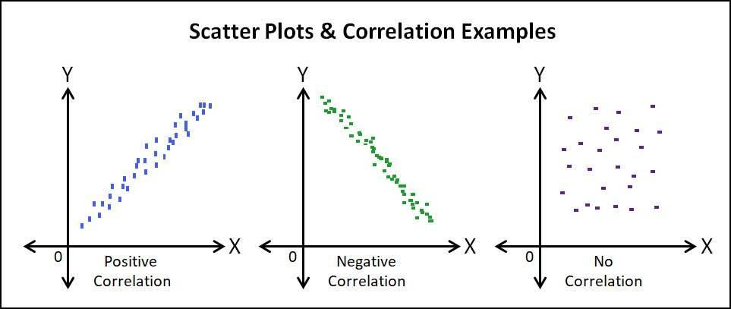

Slide 16
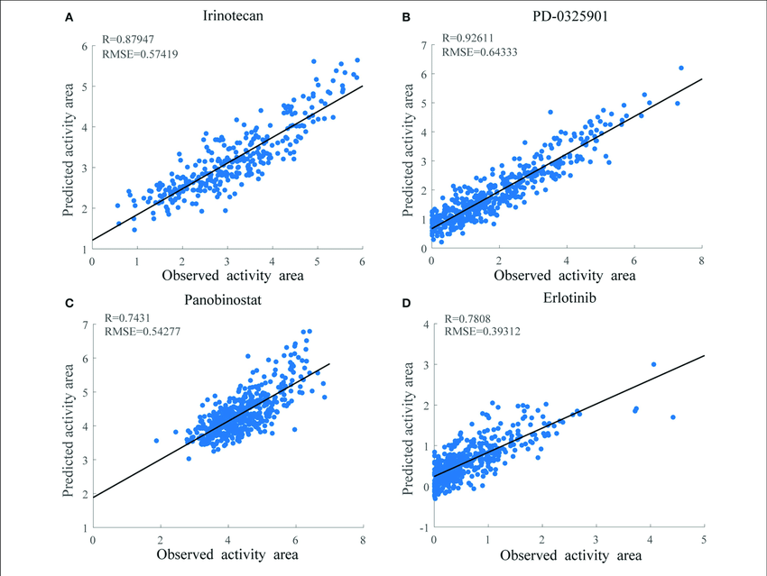
Scatter Plot

Slide 17
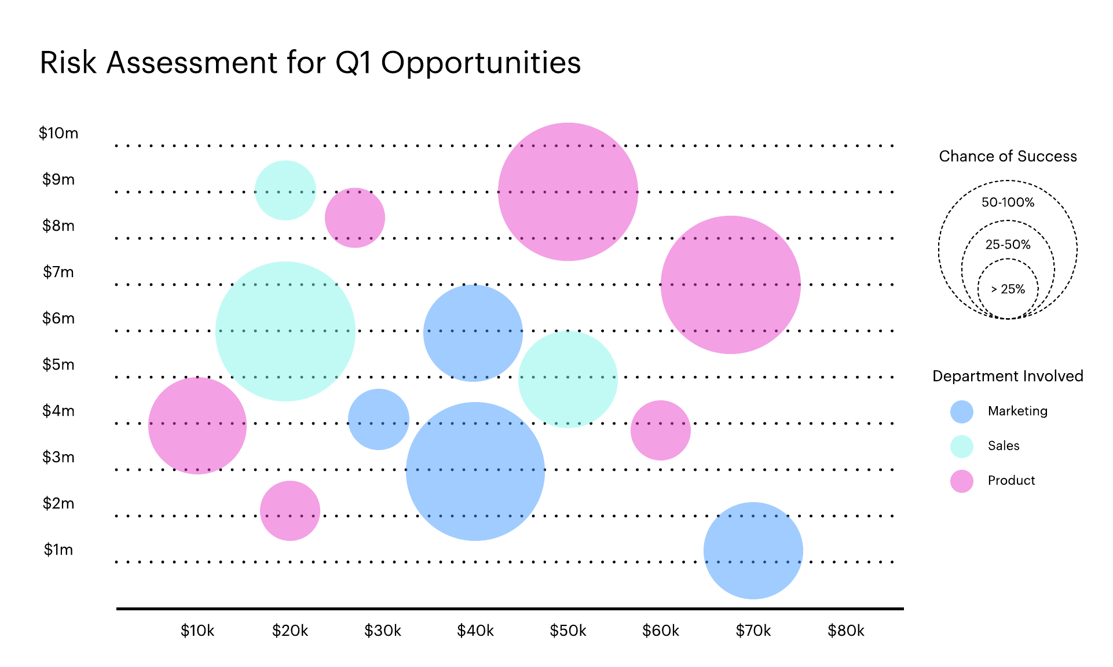
Bubble Chart

Slide 18
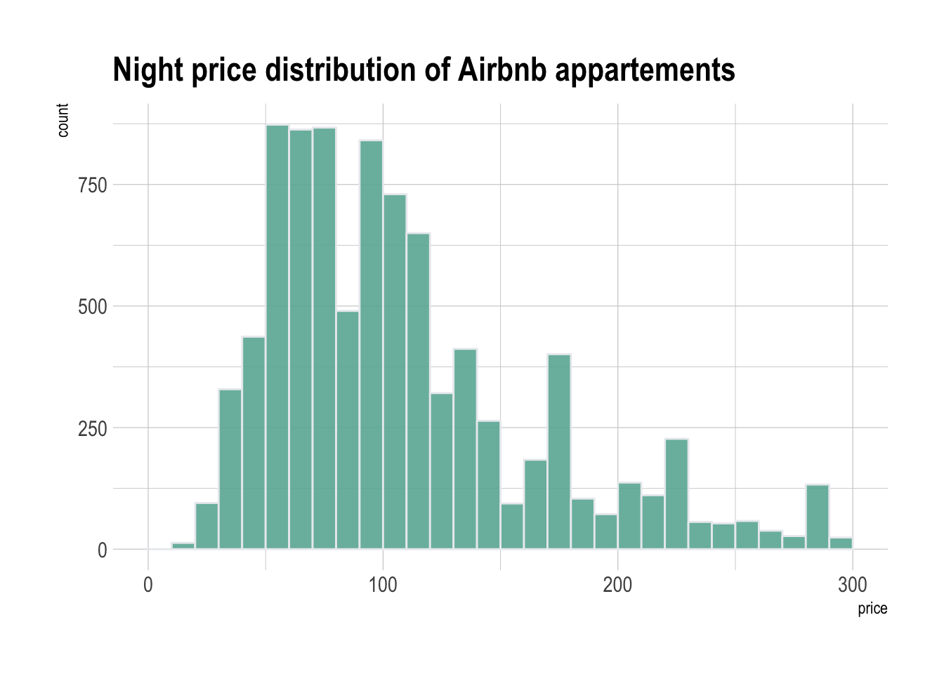
Histogram

Slide 19
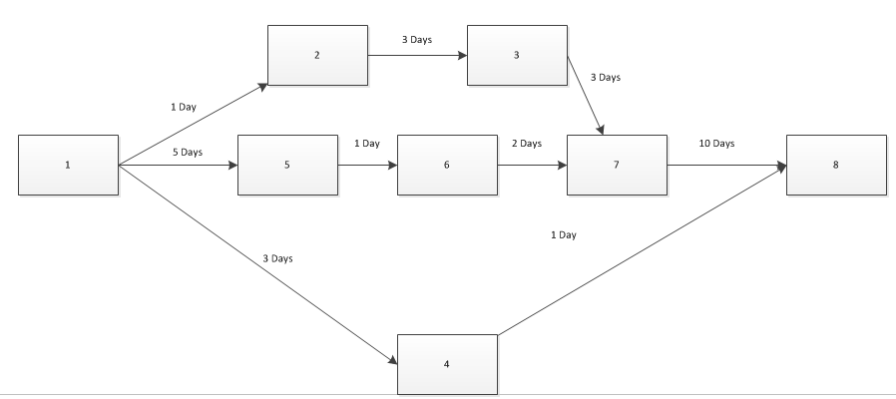
PERT Chart Program Evaluation Review Technique (PERT)

Slide 20
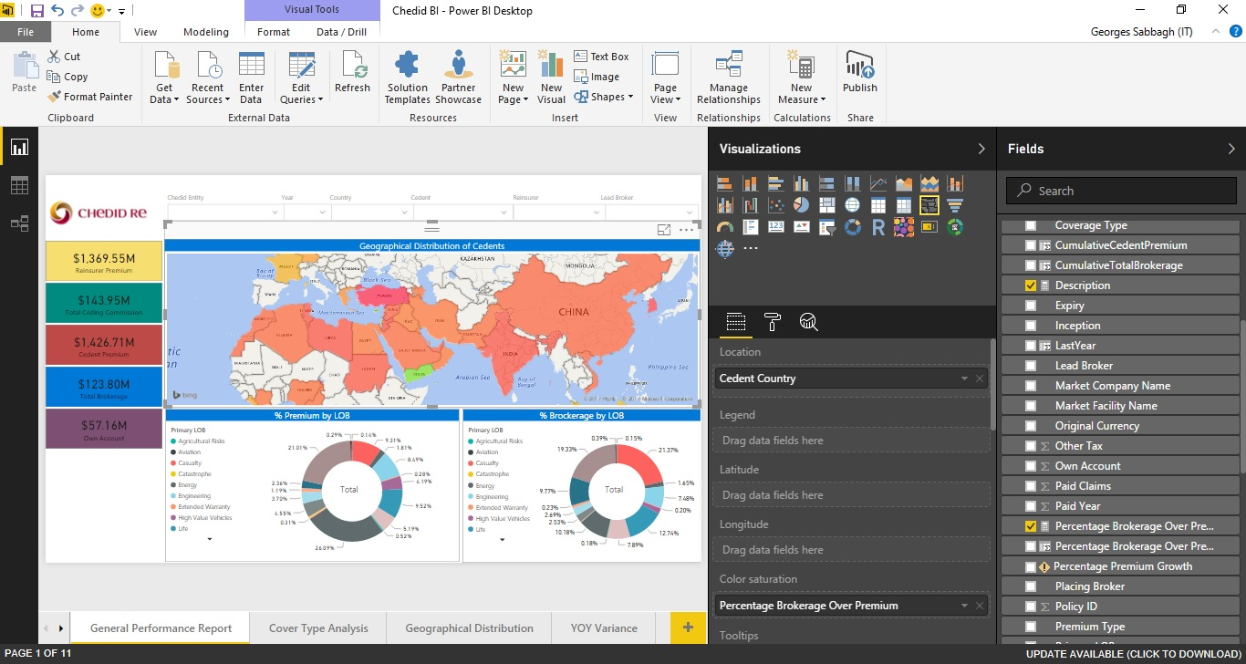
Geographic Map

Slide 21
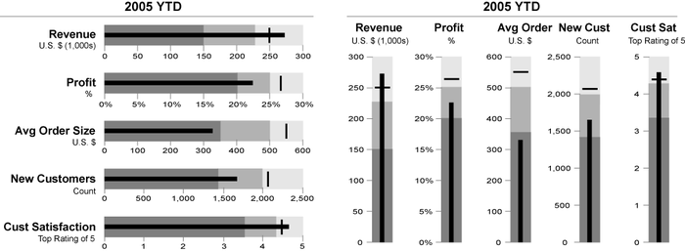
Bullet Graph

Slide 22
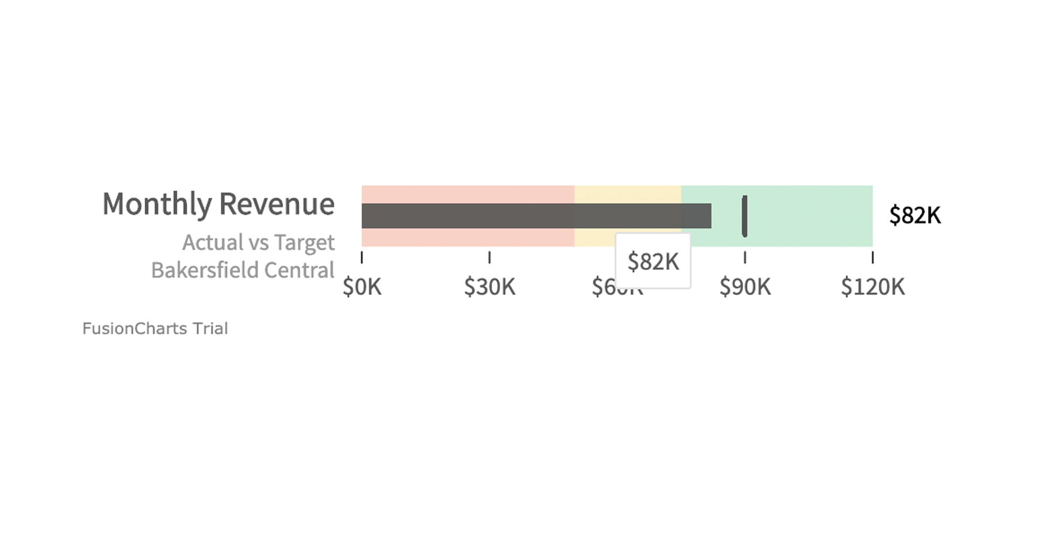
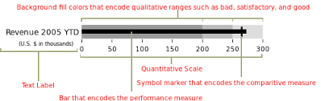

Slide 23
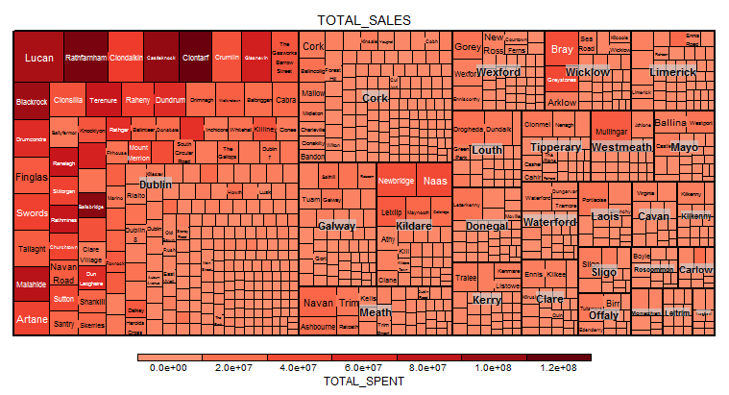
Heat Map / Tree Map

Slide 24
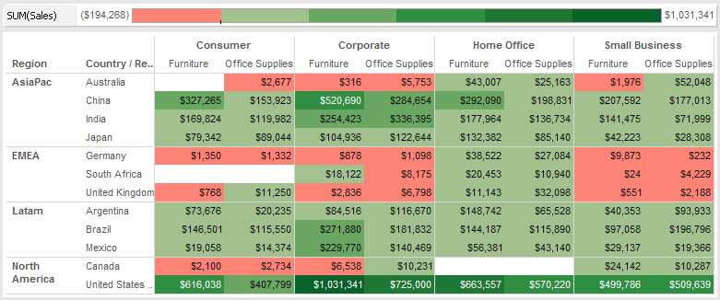
Highlight Table

